Slide 1
Introduction Kubernetes

Slide 2
What is Kubernetes?
Kubernetes is platform for hosting Docker container in a cluster environment with multiple Docker hosts
Provides high available, scaling, auto-healing.

Slide 3
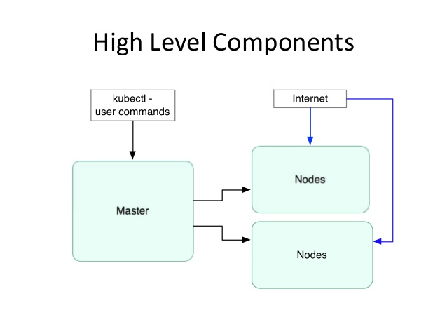

Slide 4
Key Concepts of Kubernets
Pod - A group Of Containers
Kubelet - Container agent
Proxy - Load balancer for prods
Etcd - registry service for interconnect container
Replication Controller - Manages replication of Pod
Scheduler - Schedules pod in worker nodes
API Server - Kubernetes API server

Slide 5
